Slide 1
KCET COLLEGE PREDICTOR 2022
Based on the data of year 2021, 2020,2019 (extended round 2)
By :
Omkar N. Daivajna
Adithya R.

Slide 2
AIM
To provide an approximate list of colleges available to students based on their rank by referring to previous three years data.

Slide 3
Advantages
Students get an overview of the colleges which they might get.
Provides closing rank of all the colleges based on previous years data.
User information required is very minimal.
As three years data is displayed, one can judge what college they might get in the upcoming counselling.
It is easy for the user to view the list of colleges.

Slide 4
Why use our platform
Existing websites ask for credentials of users like email address and phone number which results in spam messages down the line, making the user feel uncomfortable.
Quick and easy access to information rather than going through all the hustle of making an account on the existing websites.
Our platform gives users access to the list of the Colleges they might get, Cut-off of the eligible colleges, hyperlink to view the college website and college code which the process of selecting a college easier.

Slide 5
Technologies used
Pandas to handle data
Python to write the working code.
.csv file to store datas

Slide 6
Handling Data
It’s a once in a year process, which makes the addition of new datasets easier.
The working code is easy to change when new datasets are added.

Slide 7
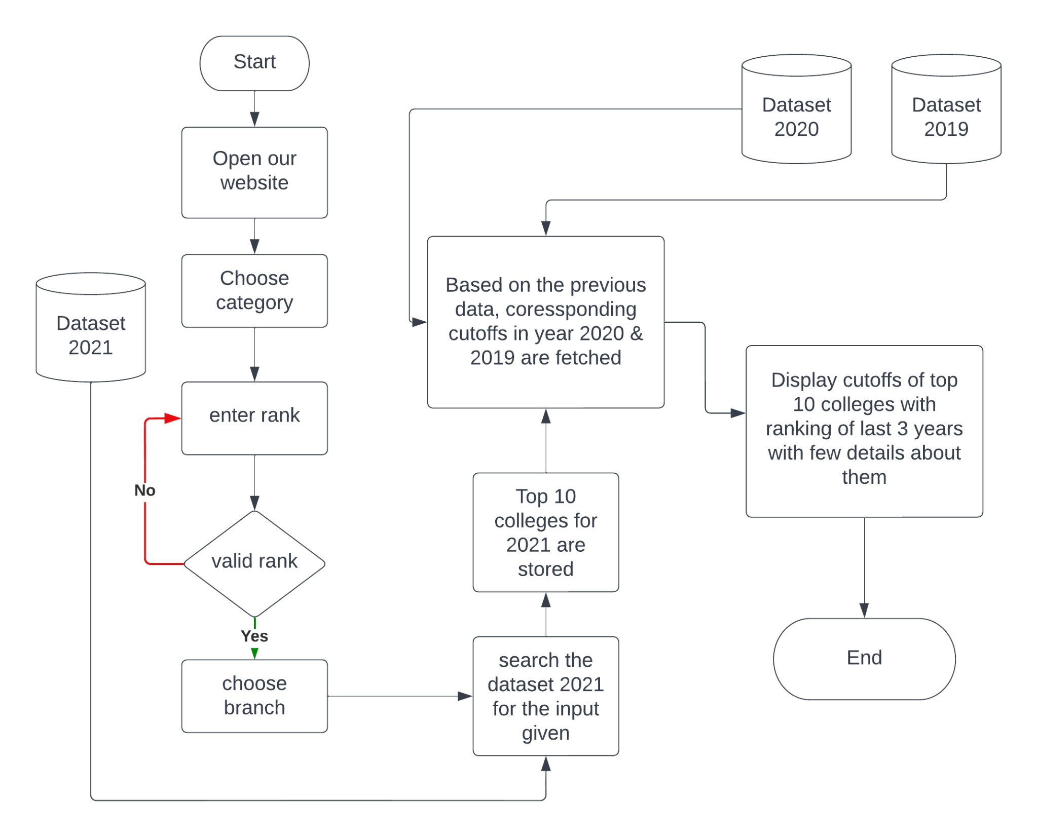
Flowchart

Slide 8
Thank You

